Slide 1
Hot Spot

Slide 2
Idea
A storage of all your favourite places.
Separated into subsections
A Map to show where they all are

Slide 3
Technologies
React Native
Google Maps Api
Google Places Api
Firebase Database

Slide 4
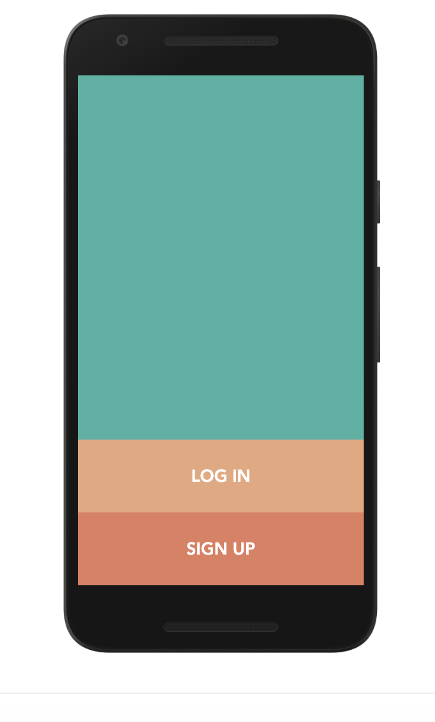
Home Screen

Slide 5
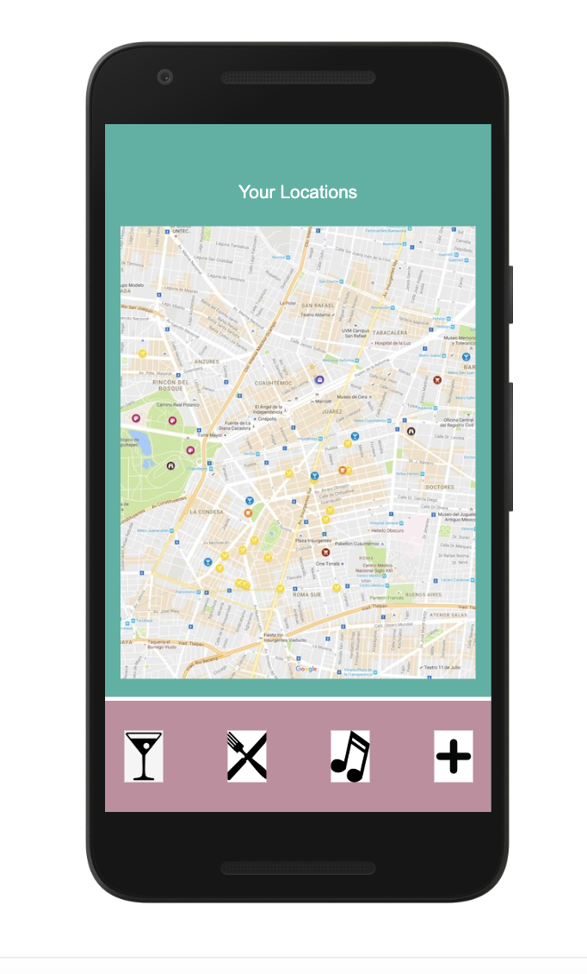
Main Screen

Slide 6
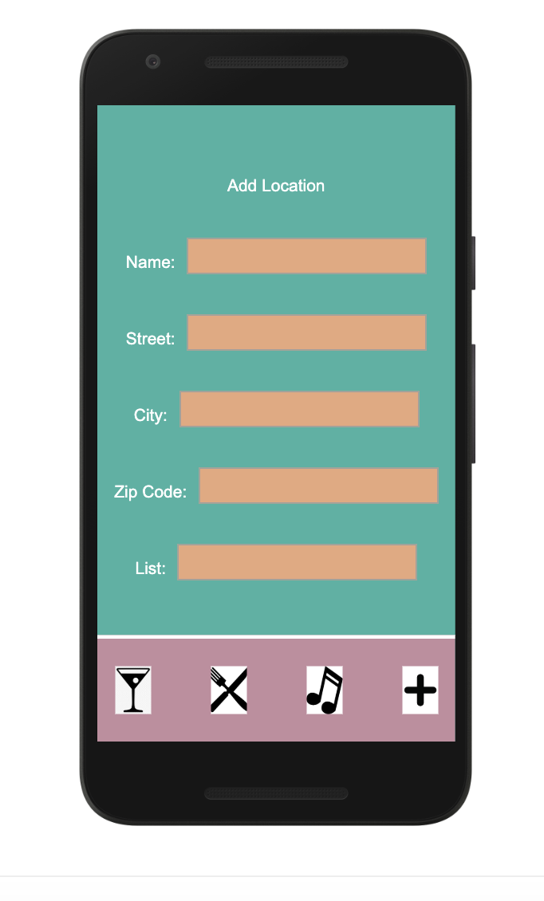
Add Screen

Slide 7
In the pipeline
Implement Login and account
Implement Places Api
Graphics

Slide 8
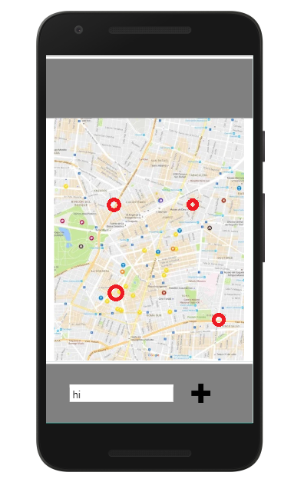
Home Screen Update

Slide 9

About Fuse
Fuse assists groups planning to meet up but need help picking a convenient location for everyone
Users invite their friends to a Fuse event and we will give you a list of locations central to everyone
Locations include restaurants, bars, parks or other public locations in your city
Your group can then discuss in our chat feature about the options and vote on a spot to go to
Finally, meetup with your friends and enjoy!

Slide 10
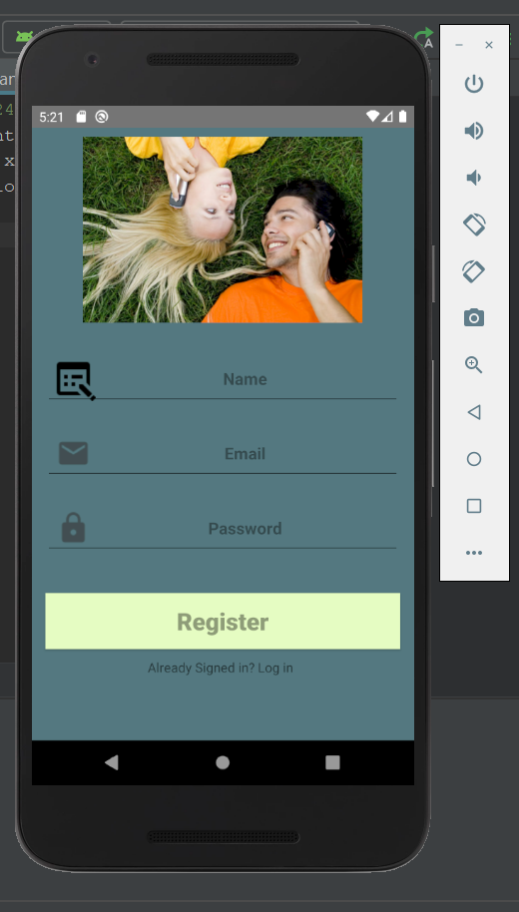
Fuse Updates

Slide 11

Fuse Updates

